Slide 1
Design Patterns

Slide 2
What is Design Patterns ?
Design Patterns are reusable solutions to the problems
Used to solve the problems of Object Generation and Integration

Slide 3
Types of Design Patterns
Gang of Four (GOF) categorized the Design Pattern into three main categories based on the three problem areas (Object Creation and Initialization, Structural Changes of Classes and Interfaces, and the Relationship Between Classes and communication Between Objects) of software architecture. They are as follows
Creational Design Pattern (Object Creation and Initialization)
Structural Design Pattern (Structural Changes of Classes, and Interfaces, and the Relationship Between Classes)
Behavioral Design Pattern (Communication Between Objects)

Slide 4
Creational Design Patterns
Helps us to centralize the object creation and initialization logic
It will create and initialize the appropriate object and return that object to the client
Then, the client can consume the object by calling the necessary methods and properties
The client does not know how the object is created and initialized

Slide 5
Creational Design Patterns
Singleton,
Factory,
Builder,
Prototype,
Abstract Factory

Slide 6
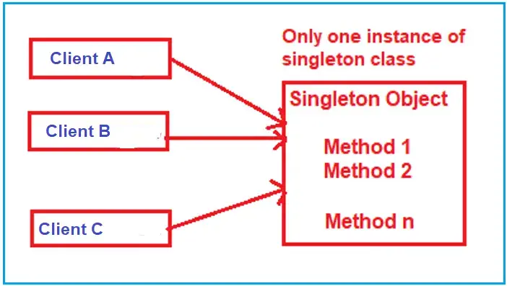
Singleton Pattern
Used to ensure that a class has only one instance and provides a global point of access to it.
When we need exactly one instance of a class to coordinate actions across the system

Slide 7
Key Characteristics of the Singleto
Single Instance
Global Access

Slide 8
Implementation steps of Singleton
Private Parameterless Constructor
Static Variable
Public Static Method or Property

Slide 9
Factory Design Pattern
A factory is an object used to create other objects.
In technical terms, a factory is a class with a method.
That method creates and returns different objects based on the received input parameter

Slide 10
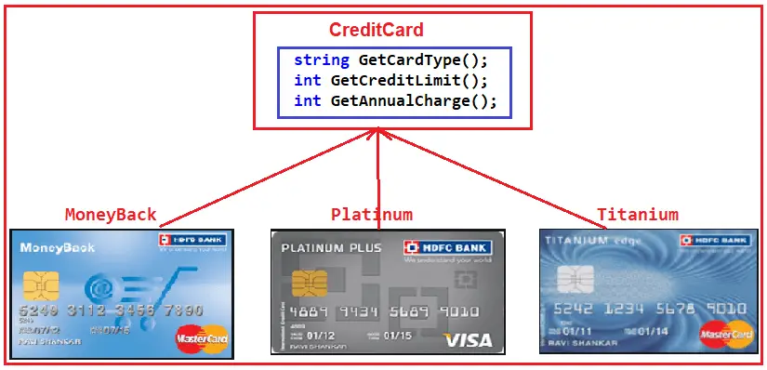
Real-Time Example to Understand Factory Design Pattern

